Slide 1
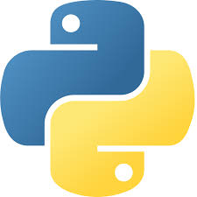
PROGRAMMING IN PYTHON

Slide 2
Unit-1 Python basics
Topics covered:-
introduction,
data types and operators,
control statements,
functions,
strings,
lists,
sets,
tuples and dictionaries

Slide 3


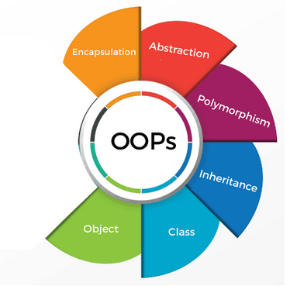
Python-Introduction
Python is a general purpose high-level programming language which supports Object Oriented programming approach to develop applications. Python was developed in 1989 by Guido Van Rossum

Slide 4
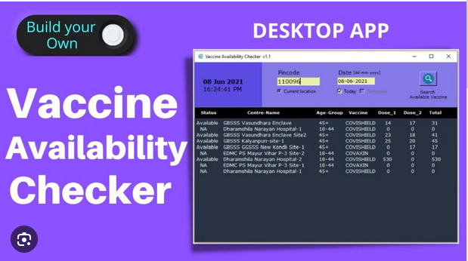

We can develop applications using Python:
Desktop applications (Tkinter library, toolkits such as the wxWidgets, Kivy, PYQT)

Slide 5
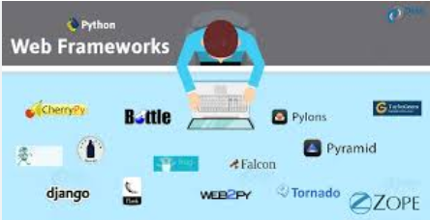

Web applications
(frameworks are Django, Flask, Pyramid,….)
web-framework named Django is used on Instagram

Slide 6


Machine Learning and Artificial Intelligence
(Library: Pandas, Scikit-Learn, NumPy)

Slide 7

Data Science and Data Visualization
(Library: Matplotlib, Seaborn)

Slide 8

Enterprise Applications (Odoo, Tryton)

Slide 9
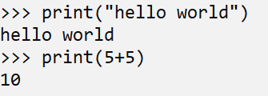
Basic Syntax:
Function to print something on Screen:
print()

Slide 10
Basic syntax
Comments :
Python supports comment in code for documentation:
1) Single Line Comment:
# This is single line comment.
2) Multi Line Comment: Python does not have a syntax for multiline comments. But, Multiline comment can be given inside triple quotes.
“”” (This is also called docstring in python)

Slide 11
Basic syntax: Indentation
To define a block of code. Python uses indentation.
A code block (body of a function, loop etc.) starts with indentation and ends with the first un-indented line.
for i n range(1,11):
print(i)
for i in range(1,11):
print(i)
Error
Correct

Slide 12
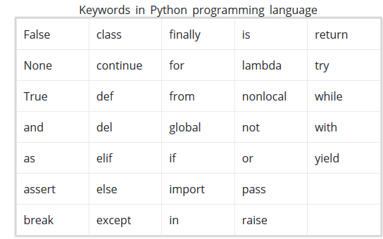
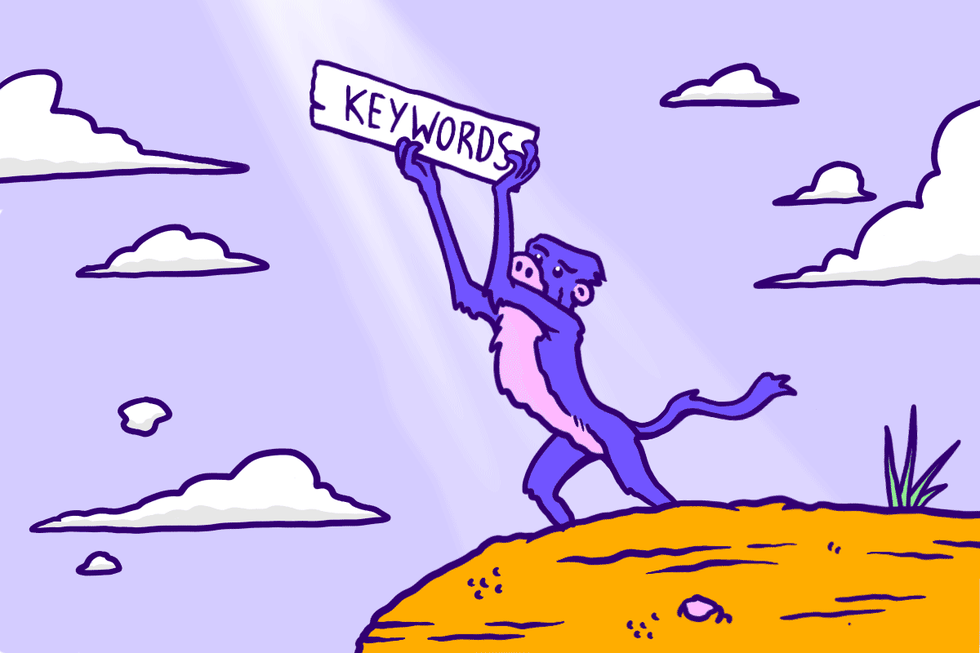
Basic syntax

Slide 13
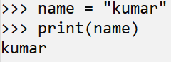
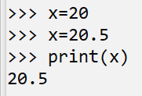
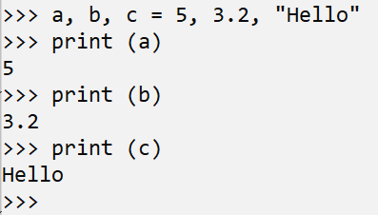
Basic syntax: Variable
A name of storage location which holds some value and during the program that value can be change also. In Python variable is not declared along with its data type although whatever you will assign the value the type of variable will be define according to that. Even in Python, a variable may be assigned a value of one type and then later re-assigned a value of a different type.
Declaring and assigning a value to a variable:
A variable may be assigned a value of one type and then later re-assigned a value of a different type.
Assigning multiple values to multiple variables

Slide 14
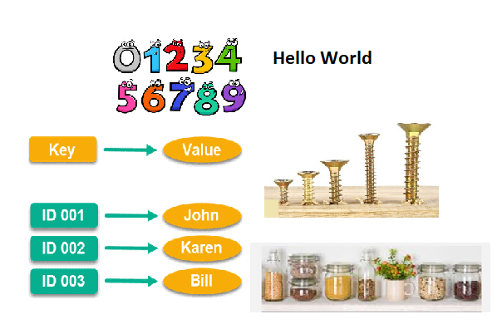
Data Types in Python

Slide 15
Data Types in Python
Numbers (Integer, Float, Complex)
String
List
Tuple
Dictionary
These datatypes we will discuss later

Slide 16
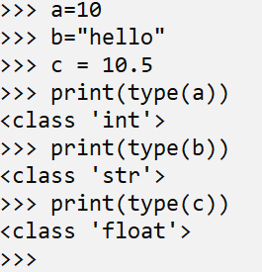
Python provides us the type() function, which returns the type of the variable passed.
a=10
b=“hello”
c = 10.5
print(type(a))
print(type(b))
print(type(c))
https://trinket.io/python3/29fc6f0126

Slide 17
Data types: Numbers
Number stores numeric values. The integer, float, and complex values belong to a Python Numbers data-type.
int - Integer value can be any length such as integers 10, 2, 29, -20, -150 etc. Python has no restriction on the length of an integer. Its value belongs to int
float - Float is used to store floating-point numbers like 1.9, 9.902, 15.2, etc. It is accurate up to 15 decimal points.
complex - A complex number contains an ordered pair, i.e., x + iy where x and y denote the real and imaginary parts, respectively. The complex numbers like 2.14j, 2.0 + 2.3j, etc.

Slide 18
Data type: String
The string can be defined as the sequence of characters represented in the quotation marks.
In Python, we can use single, double, or triple quotes to define a string.
Syntax:
str=“hello”

Slide 19
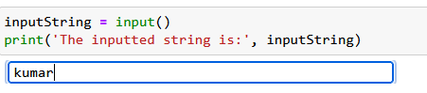
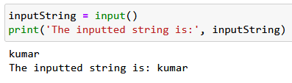
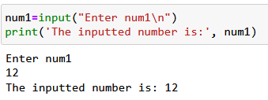
Reading Input from keyboard
The input() method reads a line from input, converts into a string and returns it.
Get input from user with a prompt

Slide 20
Operators in Python
Arithmetic operators
Assignment operators
Comparison operators
Logical operators
Identity operators
Membership operators
Bitwise operators

Slide 21
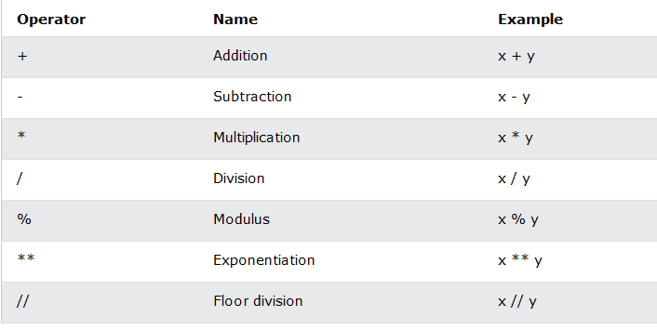
Arithmetic operators

Slide 22
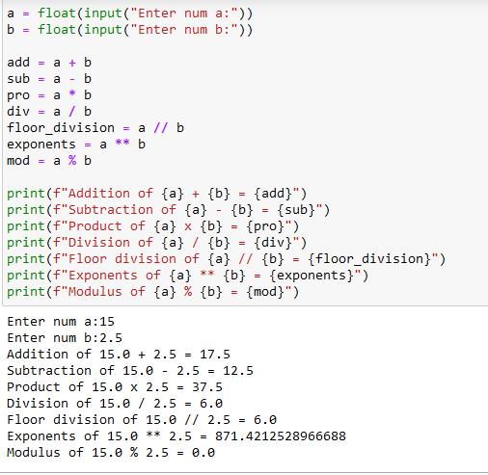
Example
Code
Output

Slide 23
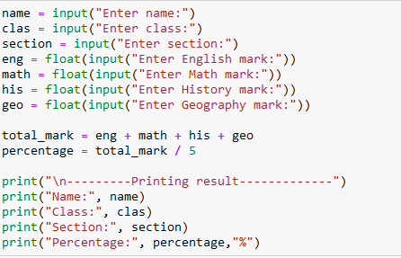
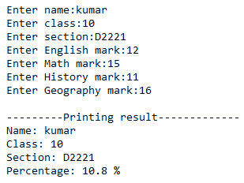
Example
Write a python program that takes in a student name, class, and section. It should also take in five subject marks of the students and find the total mark and percentage. Display a result in such a way that their name, class, section, and percentage are printed.
Code
Out
Put

Slide 24
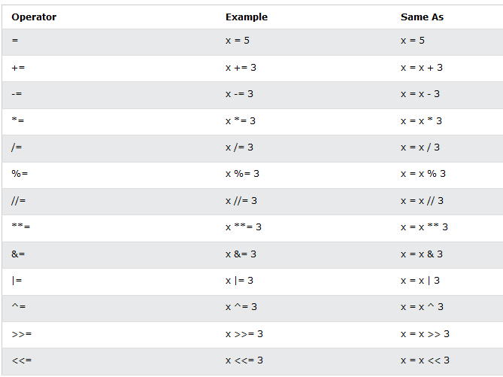
Assignment operators

Slide 25
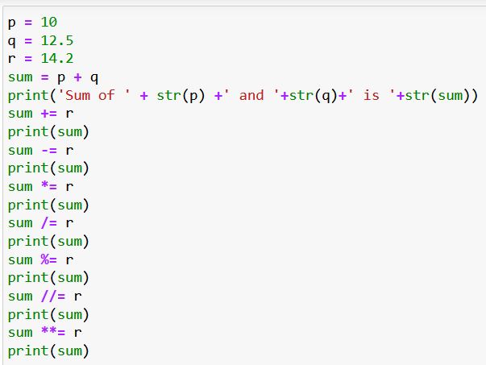
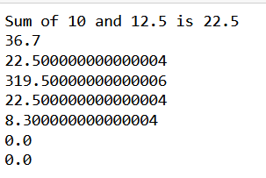
Code
E
X
A
M
P
L
E
Output

Slide 26
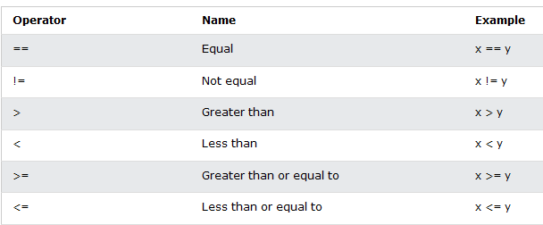
Comparison operators

Slide 27
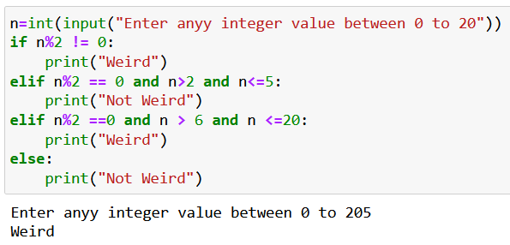
Code
Out
put

Slide 28
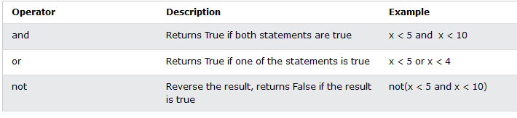
Logical operators

Slide 29
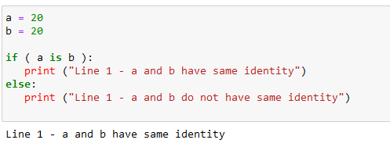
Identity operators: is, isnot
Identity operators are used to compare the objects, not if they are equal, but if they are actually the same object, with the same memory location.
Note: The built-in id() a function is used to get the “identity” of an object.

Slide 30
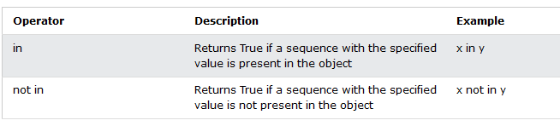
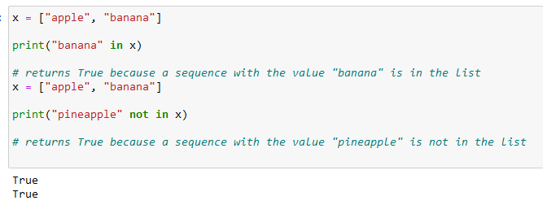
Membership operators

Slide 31
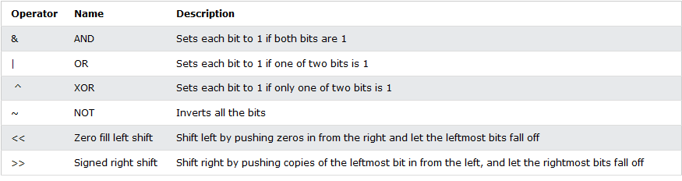
Bitwise Operators

Slide 32
Control statements
Control statements are used to control the flow of the execution of the program using:
Conditional Statements
Looping Statements
Jumping statements

Slide 33
Conditional Statements in Python
Syntax:
A) if... statements
if test expression:
statement(s)
B) if...else statements
if test expression:
Body of if
else:
Body of else

Slide 34
C ) if...elif statements
if test expression:
Body of if
elif test expression:
Body of elif
else:
Body of else

Slide 35
D) Nested if statements:
if statements inside if statements, this is called nested if statements
if test expression:
Body of if
if test expression:
body of if
else:
body of else
else:
body of else

Slide 36
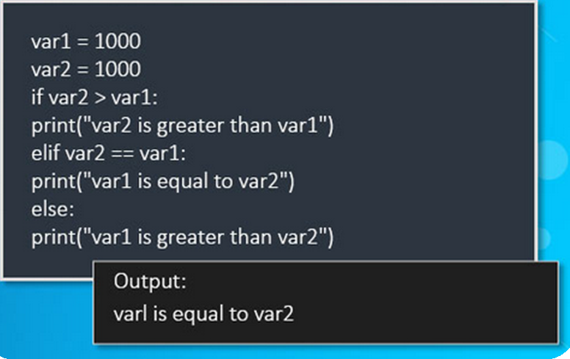
Example

Slide 37
Note
Python language does not have any switch statements. But you can Implement switch statement using Dictionary of Strings.

Slide 38
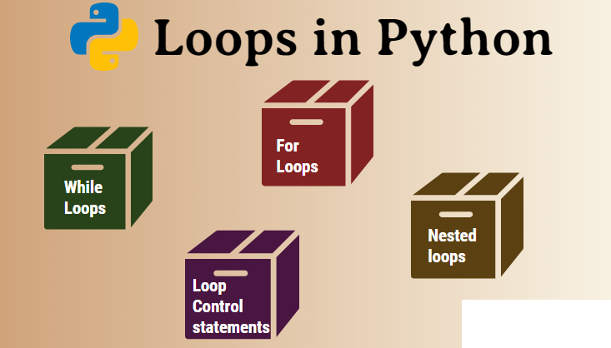
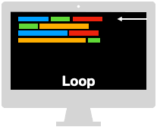

Slide 39
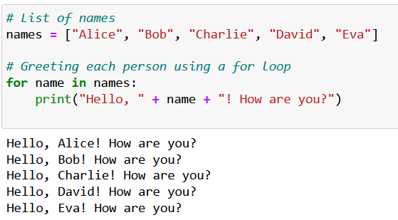
For loop
“for” loop is used for iterating over a sequence.
Syntax:
for iteration_variable in sequence:
statement(s)
Sequence can be string, list, tuple, dictionary or range() function.
Let's consider a situation where you have a list of names and you want to greet each person in the list using a for loop in Python:

Slide 40
While Loop
The While Loop is a type of entry-level control statement that can be used for executing a set of code repeatedly based on a condition.
Syntax:
while expression:
body of the loop
Let's consider a situation where you want to calculate the number of years it takes for a bank account balance to reach a certain target amount with a given annual interest rate, assuming you deposit a fixed amount every month.
We'll use a while loop to keep adding the monthly deposit and interest to the balance until it reaches the target amount.
Note: you can use while with else also.

Slide 41
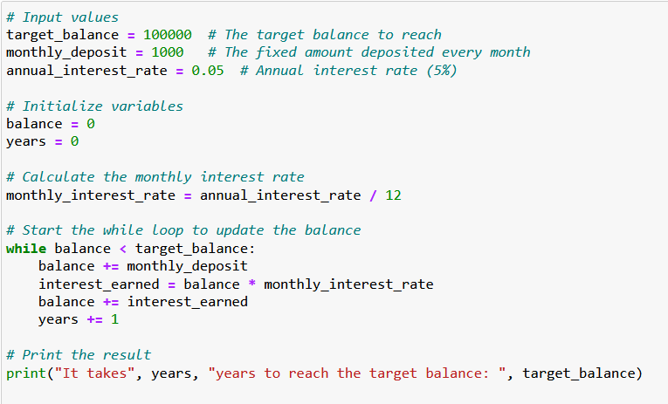
Code
Out put

Slide 42
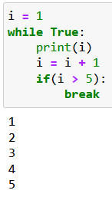
Do While Loop
The Do While Loop conditional statement is used for an exit level control flow of code implementation that ensures the code block is executed at least once before the control reaches the while condition.
In Python, there is no dedicated do while conditional loop statement, and so this function is achieved by creating a logical code from the while loop, if statement, break and continue conditional statements.

Slide 43
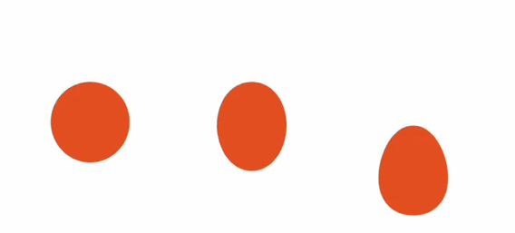
Jumping statements
1) Break
2) Continue
3) Pass

Slide 44
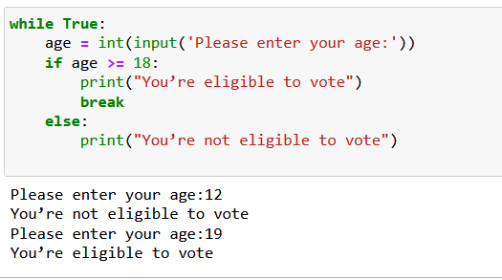
break statement
Code
The break statement in Python is used to terminate a loop.
If the break statement is used inside a nested loop, it terminates the innermost loop and the control shifts to the next statement in the outer loop.
Output

Slide 45
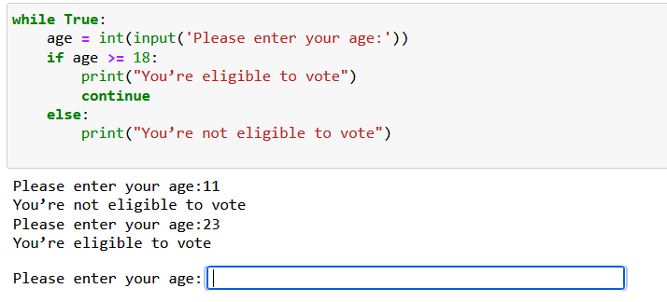
Continue in Python
When the program encounters a continue statement, it will skip the statements which are present after the continue statement inside the loop and proceed with the next iterations.
Code
Out put

Slide 46
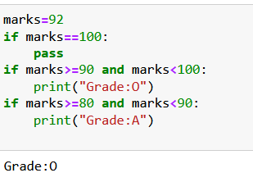
pass statement
Code
The pass statement is a null statement.
When the user does not know what code to write, So user simply places pass at that line.
Output

Slide 47
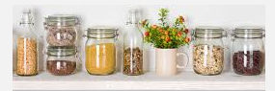
Datatype: List
The items stored in the list are separated with a comma (,) and enclosed within square brackets [].
List is mutable in nature.
The list can contain data of different types.
Syntax:
list1 = [1, "hi", "Python", 2.5]

Slide 48
Accessing List By using indexing in Python

Slide 49
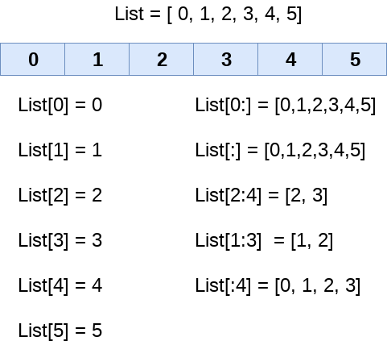
Accessing List By using the slicing operator
List[1:6:2]={2,4,6}
list_varible(start:stop:step)

Slide 50
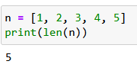
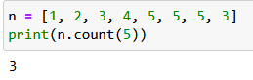
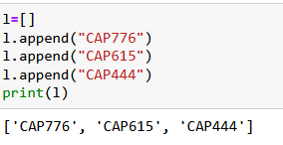
Functions/methods in list:
len() function in python:
This function when applied to a list will return the length of the elements in it.
count() method in Python:
This method returns the number of occurrences of a specific item in the list
append() method in Python:
Using this method we can add elements to the list. The items or elements will be added at the end of the list.

Slide 51
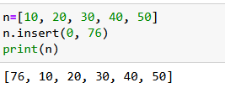
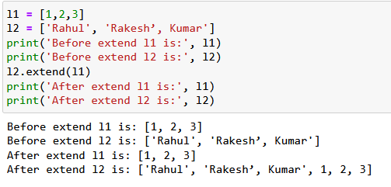
Functions/methods in list:
insert() method in Python:
We can add elements to the list object by using the insert() method. The insert() method takes two arguments as input: one is the index and the other is the element. It will add the elements to the list at the specified index.
extend() method in Python:
Using this method the items in one list can be added to the other.

Slide 52
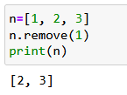
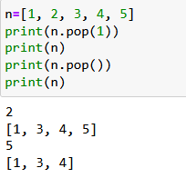
Functions/methods in list:
remove() method in Python:
We can use this method to remove specific items from the list. If the item exists multiple times, then only the first occurrence will be removed. If the specified item not present in list, then we will get ValueError.
pop() method in Python:
This method takes an index as an argument and removes and returns the element present at the given index. If no index is given, then the last item is removed and returned by default.

Slide 53
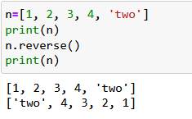
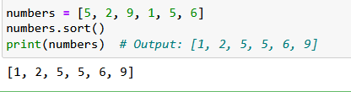
Functions/methods in list:
reverse() method in python:
This method reverses the order of list elements.
sort() method in Python:
In a list by default insertion order is preserved. If we want to sort the elements of the list according to the default natural sorting order then we should go for the sort() method. For numbers, the default natural sorting order is ascending order. For strings, the default natural sorting order is alphabetical order. To use the sort() method, the list should contain only homogeneous elements otherwise, we will get TypeError.

Slide 54
Tuple:
Like lists, tuples also contain the collection of the items of different data types.
The items of the tuple are separated with a comma (,) and enclosed in parentheses ().
A tuple is a read-only data structure as we can't modify the size and value of the items of a tuple.
Syntax:
mytuple=(1, "hi", "Python", 2)

Slide 55

Accessing Tuple By using the slicing operator

Slide 56

Functions/methods in tuple:
max(): This function returns the large element from the tuple.
min(): This function returns the minimum element from the tuple.
len(): This function returns the number of elements in a tuple.
tuple(): Creating a tuple from a list , string, set, dictionary etc..
count() method: This method returns the number of occurrences of a specified element in the tuple.
index() method: This method returns the index of the first occurrence of a specified element in the tuple.

Slide 57

Dictionary
Dictionary is an unordered set of a key-value pair of items.
The items in the dictionary are separated with the comma (,) and enclosed in the curly braces {}.
The values can be accessed in the dictionary by using the keys as keys are unique in the dictionary.
Keys can be immutable values. Like: int, float, string, Boolean, tuple

Slide 58



Functions/Methods in Dictionary
len(): gives the total length of the dictionary. This would be equal to the number of items in the dictionary.
clear(): dictionary method clear() removes all items from the dictionary.
fromkeys(): dictionary method fromkeys() creates a new dictionary with keys from seq and values set to value.

Slide 59

Functions/Methods in Dictionary
get() :dictionary method get() returns a value for the given key. If key is not available then returns default value None.
items() : dictionary method items() returns a list of dict’ s (key, value) tuple pairs
keys() : dictionary method keys() returns a list of all the available keys in the dictionary.
values(): dictionary method values() returns a list of all the values available in a given dictionary.

Slide 60
Set
Sets are used to store multiple items in a single variable.
A set is a collection which is both unordered and unindexed.
Sets are written with curly brackets.
Set items are unordered, unchangeable, and do not allow duplicate values.
Syntax:
myset = {"apple", "banana", "cherry"}

Slide 61

Functions/methods in set:
add(): Adds an element to the set. If the element is already present, it has no effect
remove(): Removes the specified element from the set. Raises a KeyError if the element is not found.
clear(): Removes all elements from the set, making it empty.
discard(): Removes the specified element from the set. If the element is not found, it has no effect.

Slide 62
Any Query?

